Slide 1
Skin Lesion Classification
Souparno Chattopadhyay

Slide 2
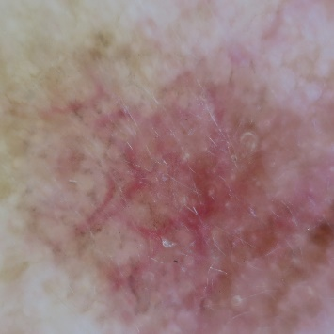
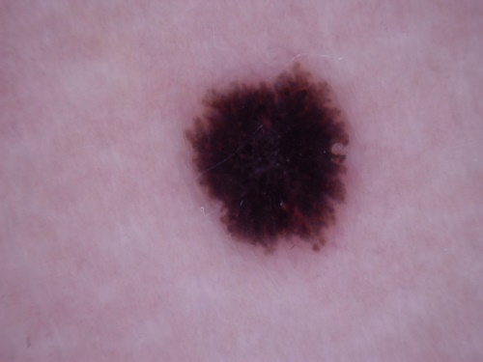
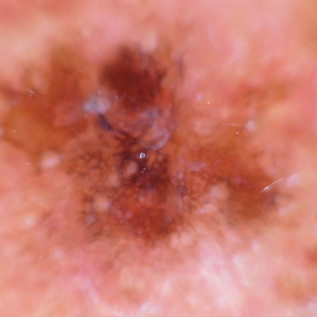
Problem Statement
Binary Classification
Nevus Others
Dermatofibroma , Melanoma , Basal Cell Carcinoma

Slide 3
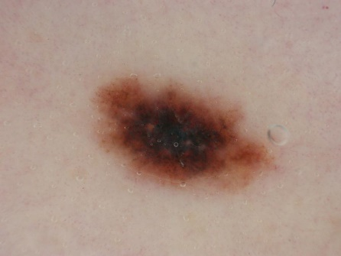
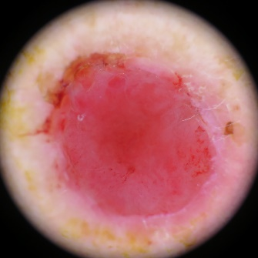
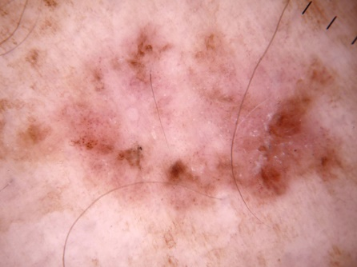
Problem Statement
Three Class Problem
Melanoma Basal Cell Carcinoma Squamous Cell Carcinoma

Slide 4
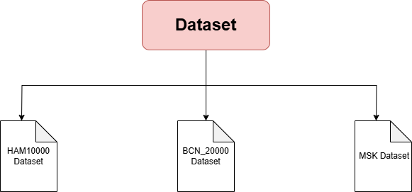
Data Preparation & Preprocessing

Slide 5
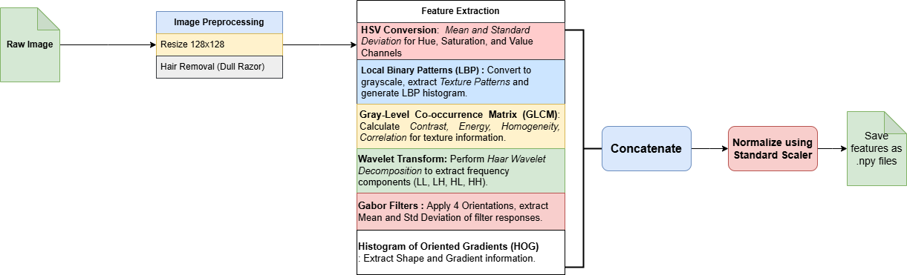
Data Preparation & Preprocessing
Preprocessing Pipeline
Without Segmentation

Slide 6
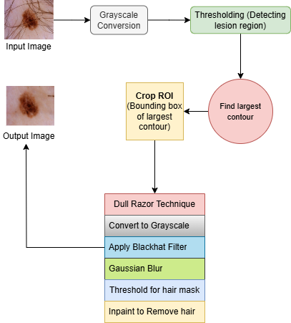

Data Preparation & Preprocessing
Dull Razor Technique
Hair Removal

Slide 7
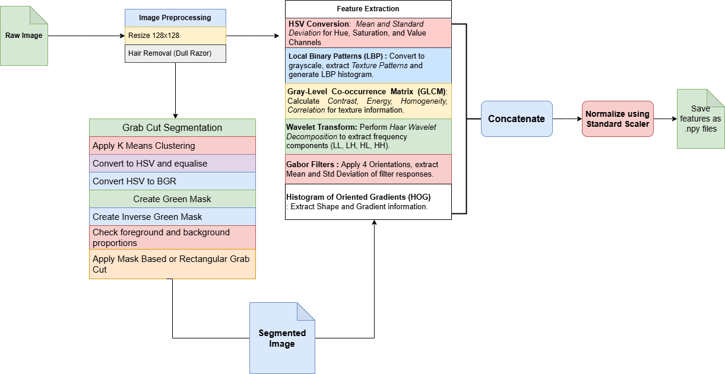
Data Preparation & Preprocessing
Preprocessing Pipeline
With Segmentation

Slide 8
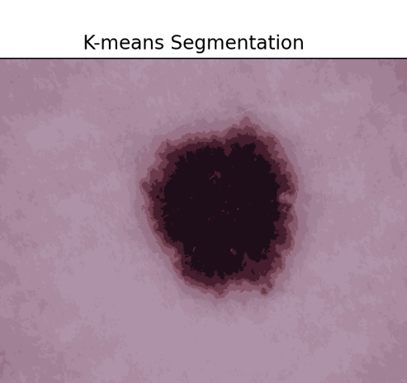
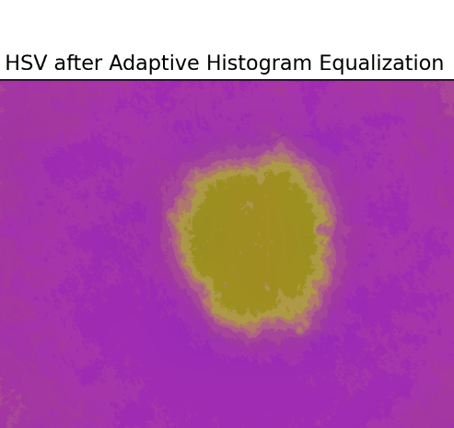
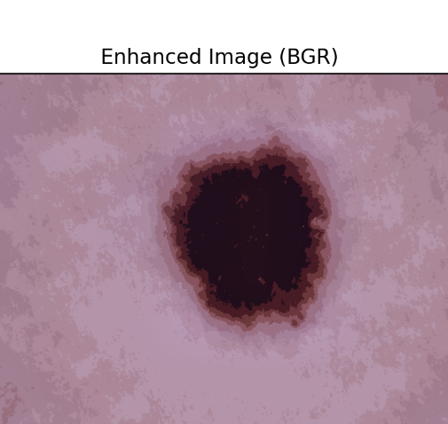
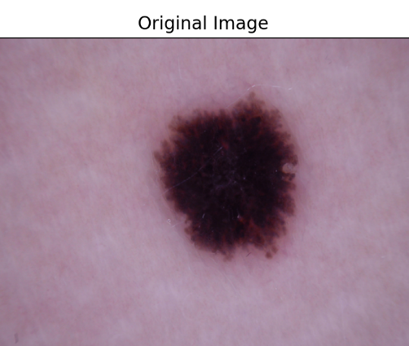
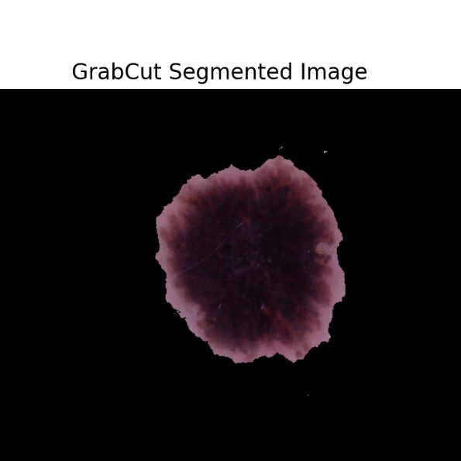
Data Preparation & Preprocessing
Segmentation Pipeline
Visualising Grab Cut Results

Slide 9
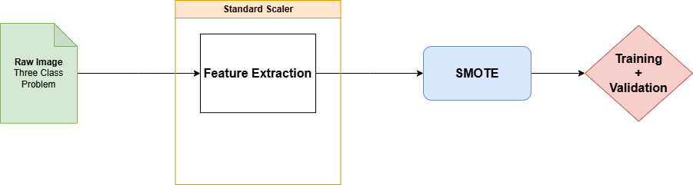
Data Preparation & Preprocessing
Class Imbalance Problem
Three Class Classification (Scc)

Slide 10
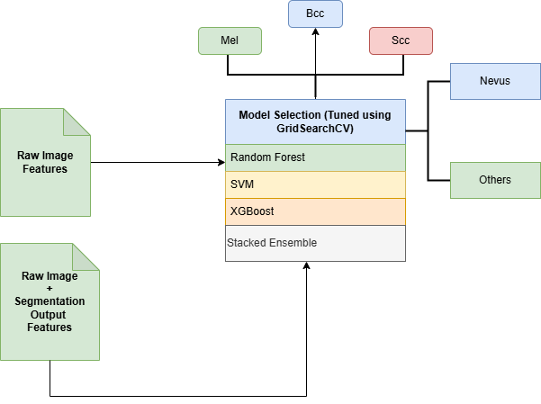
Model Architecture and Training

Slide 11
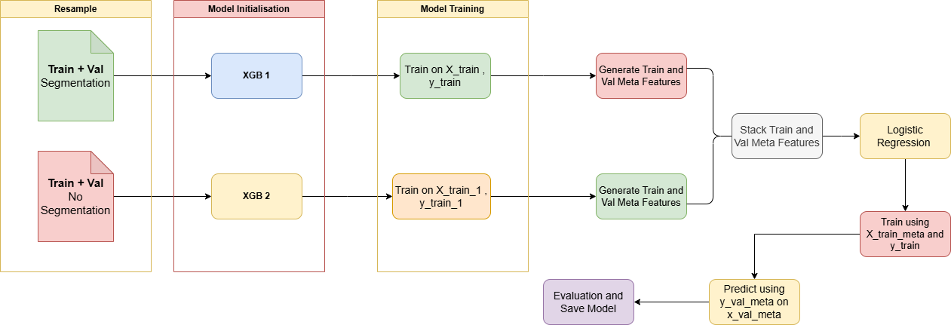
Model Architecture and Training
Stacked Ensemble Method

Slide 12
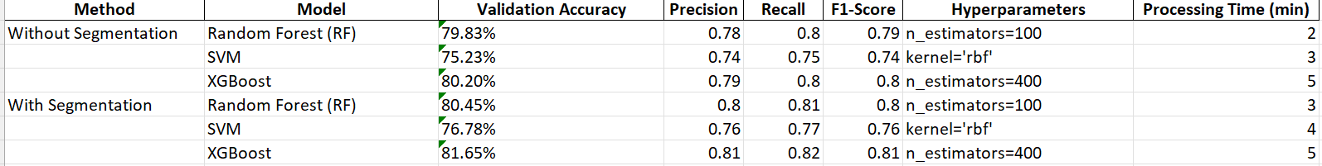
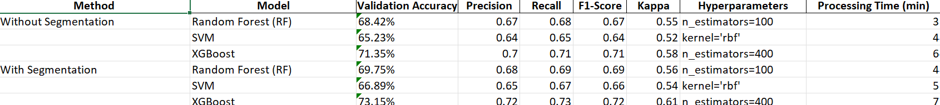
Evaluation Metrics and Results
Experimental Models
Two Class Problem
Three Class Problem

Slide 13
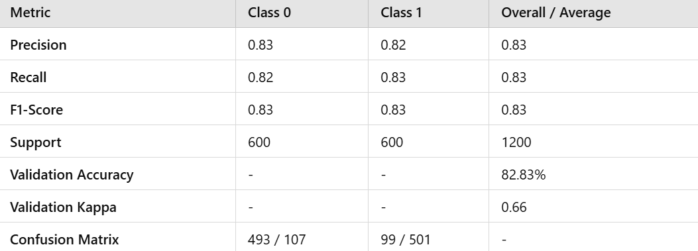
Evaluation Metrics and Results
Stacked Ensemble
Binary Classification

Slide 14
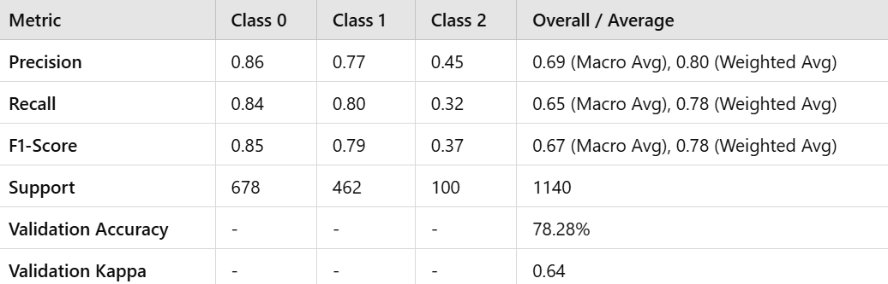
Evaluation Metrics and Results
Stacked Ensemble
Three Class Classification

Slide 15
Conclusion
The Pipeline achieved high accuracy in skin lesion classification: Binary (Nevus vs. Others): 82.83% and Three-Class (Melanoma, BCC, SCC): 78.28%.
The stacked ensemble model improved overall performance, highlighting potential in early and precise dermatological diagnosis.

Slide 16


